Slide 1

Video Analytics / Vision Apps Use Case Face-Based Attendance Monitoring System using CP Plus IP Camera
By
Aditya Shirke and Dipti Sable

Slide 2
INTRODUCTION
The project aims to develop an automated attendance system using face recognition technology. The system captures live stream from CP Plus Camera, identifies the employee and mark the attendance.
Objectives :
Integrate CP Plus speed dome cameras for real-time video streaming and employee recognition.
Develop an intuitive registration interface for addition of employees.
Automate attendance marking with precise time logging.
Store and manage attendance data efficiently for reporting and analysis.
Attendance tracking.

Slide 3
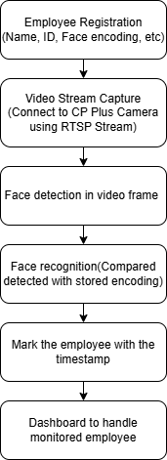
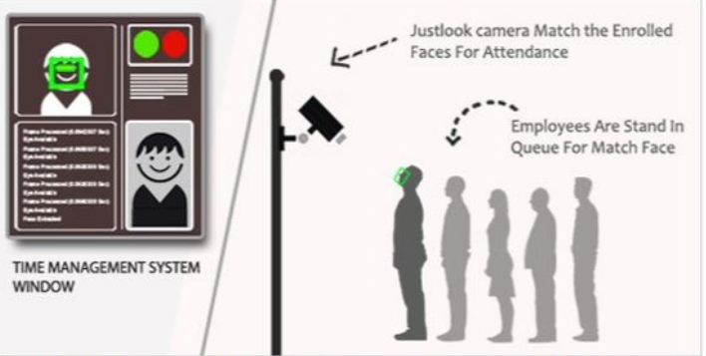
SYSTEM ARCHITECHURE

Slide 4
Registration Module
Feature Extraction Module
Initialize Face Detector ( Dlib )
Load Employee Data
Input fields for employee details
Initialize Face Recognition Models
Capture Video (OpenCV)
Access images stored in Folder
Check Existing Faces
Detect Faces in Images
Create a Folder for Each Employee
Extract 128D Face Features
Compute face embeddings using the ResNet model.
Save Employee Data
Display Confirmation messages
Store Features in CSV

Slide 5
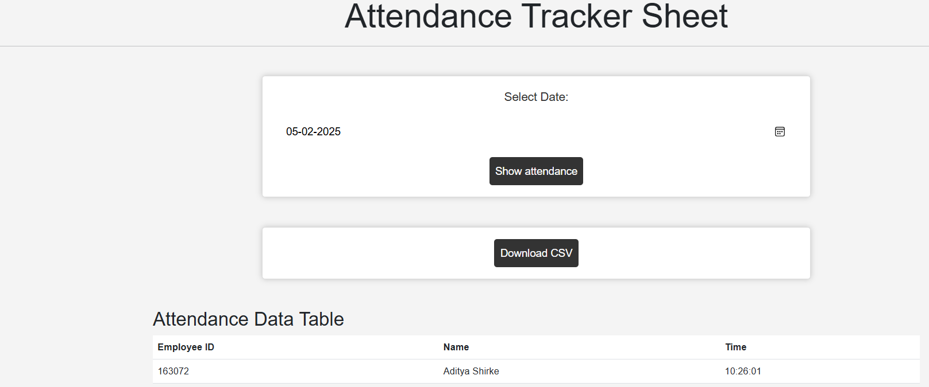
Attendance Taker Module
Load Dlib Models
Create a table for storing attendance
Face Database Loading
Start Video Stream
Face Recognition
Track faces across frames
mark attendance in the database

Slide 6

Database Process Flow
User input via Registration Page
Download the csv file
Face_data.db
Attendance.db
Face detected in the video frames
Match Found
The detected face is compared against stored embeddings

Slide 7
TECHNOLOGIES USED
HARDWARE
SOFTWARE
CP Plus Speed Dome Camera (RTSP Streaming)
NVR
POE switch
Python : OpenCV, Dlib, SQLite3, Pandas
Tkinter : To build the Registration GUI.
Dlib Face Recognition Model : ResNet-50
SQLite Database : attendance storage

Slide 8
THANK YOU

